Slide 1
Opening a Pub in Mumbai
IBM Data Science Capstone Project – Coursera
Yatharth Aggarwal – April, 2020

Slide 2
Business Problem
Location of a pub is one of the most important decisions that will determine whether the pub will be a success or a failure
Objective: To analyse and select the best locations in the city Mumbai, India to open a new pub
This project is timely as the city is currently suffering from oversupply of pubs
Business question
In the city of Mumbai , India, if a property developer is looking to open a new pub, where would you recommend that they open it?

Slide 3
Data
Data required
List of neighbourhoods in Mumbai
Latitude and longitude coordinates of the neighbourhoods
Venue data, particularly data related to Pubs
Sources of data
Wikipedia page for neighbourhoods
(https://en.wikipedia.org/wiki/Category:Suburbs_in_Mumbai)
Geocoder package for latitude and longitude coordinates
Foursquare API for venue data

Slide 4
Methodology
Web scraping Wikipedia page for neighbourhoods list
Get latitude and longitude coordinates using Geocoder
Use Foursquare API to get venue data
Group data by neighbourhood and taking the mean of the frequency of occurrence of each venue category
Filter venue category by Pub
Perform clustering on the data by using k-means clustering
Visualize the clusters in a map using Folium

Slide 5
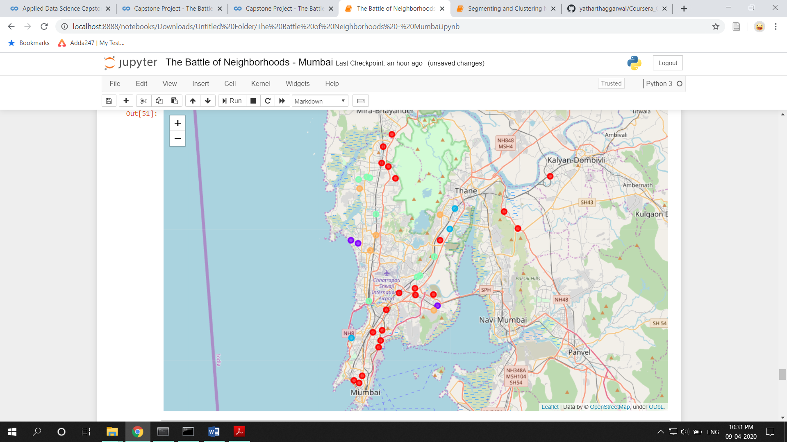
Results
Categorized the neighbourhoods into 3 clusters :
Cluster 0: Neighbourhoods with high number of pubs
Cluster 1, 2: Neighbourhoods with very less or no number of pubs
Cluster 3, 4: Neighbourhoods with more than 5 pubs

Slide 6
Discussion
Most of the pubs are concentrated in the southern area of the city
Highest number in cluster 0 and moderate number in cluster 3 and 4
Cluster 1 and 2 has very low number to no pub in the neighbourhoods
Oversupply of pubs mostly happened in the southern area of the city, with the suburb area still have very few pubs

Slide 7
Recommendations
Open new pubs in neighbourhoods in clusters 1 and 2 with little to no competition
Can also open in neighbourhoods in cluster 3 with moderate competition if have unique selling propositions to stand out from the competition
Avoid neighbourhoods in cluster 0, already high concentration of pubs and intense competition

Slide 8
Conclusion
Answer to business question: The neighbourhoods in cluster 4 are the most preferred locations to open a new pub
Findings of this project will help the relevant stakeholders to capitalize on the opportunities on high potential locations while avoiding overcrowded areas in their decisions to open a new pub

Slide 9
Thank You

